Slide 1
STEWARDSHIP MINISTRIES
North Zimbabwe Conference
Muzarabani Seminar 1-4 May 2016
Systematic Benevolence
&
Combined Offerings
Plan
.

Slide 2
Ndouya KuMchinjiko – Hymn 21
Ndouya kumchinjiko, ubofo neurombo
Handidi chimwe chiro asi ruponeso-ro.
Ndosimbira kunemwi, Nyenye yepaCalvary
Ndinopfugama pasi, mundiponese ini.
Jesu ndokuchemera, Moyo wangu waipa
Jesu ye wataura, Ndinozo-kuchenura.
Ndapa zvese kunemi, zviro zvese zvepasi
Moyo zve nemuviri, uwe wenyu narini.
Ndosimbira kunemi, mune zvitsidzo zvenyu
Zvino ndarapwa ini, neroparo raKristu.
Jesu arikuuya; Moyo wangu wazara
Zvino ndakachenurwa; Mbiri kuna Jehova.

Slide 3
“I saw that in the arrangement of systematic benevolence, hearts will be tested and proved. It is a constant, living test. It brings one to understand his own heart, to see whether the truth or the love of the world predominates…” E. G. White.

Slide 4
Systematic benevolence makes the local church to operate on a budget.
The church may accomplish a lot of projects within a stipulated time.
A practical test to prove our commitment to our calling.

Slide 5
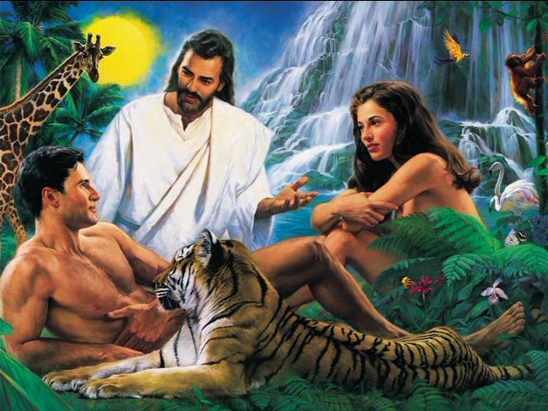
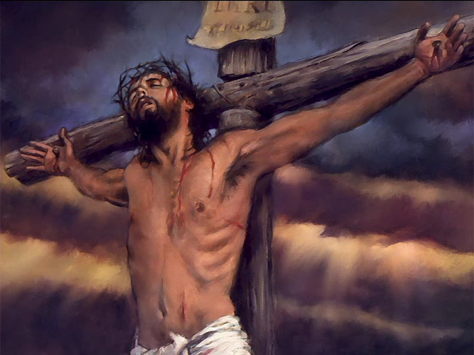
STEWARDSHIP MINISTRIES
North Zimbabwe Conference
RELATIONSHIP BETWEEN TITHE & OFFERINGS
Tithe
10%
Recognition
Offerings
%++
Gratitude
My Lord/Creator
My Saviour
Relationship

Slide 6
STEWARDSHIP MINISTRIES
North Zimbabwe Conference
RELATIONSHIP BETWEEN TITHE & OFFERINGS
You created me
but I doubt my
salvation
O
F
F
E
R
I
N
G
S
M
I
S
S
I
N
G
P
A
R
T
Tithe
10%
Doubt
My Lord/Creator
Ungratefulness

Slide 7
STEWARDSHIP MINISTRIES
North Zimbabwe Conference
RELATIONSHIP BETWEEN TITHE & OFFERINGS
M
I
S
S
I
N
G
P
A
R
T
You saved me
For what?
Offerings
%++
T
I
T
H
E
I thank you
but something
is missing
My Saviour
Relationship ??

Slide 8
STEWARDSHIP MINISTRIES
North Zimbabwe Conference
SIGNIFICANCE OF TITHE & OFFERINGS
Tithe
10%
Recognition
Offerings
%++
Gratitude
My Lord/Creator
My Saviour
Twice we are His
By Creation
& Redemption
(Isa. 43:1)

Slide 9
STEWARDSHIP MINISTRIES
North Zimbabwe Conference
Offerings

Slide 10
Offerings
Our response of love to God’s loving kindness.
A gesture of appreciation/gratefulness
Thanks giving
A spiritometer which determines how deep and serious our relationship is to our God

Slide 11
Offerings
(Chipavhurire vs Chipavharire)
Prov. 11:25
“The liberal soul shall be made fat; And he that watereth shall be watered also himself.”
(ASV)
The Bible teaches us to be generous in giving offerings. There is no limit. ( Chipavhurire)
“Chipavhurire anokodzwa…….
“Chipavharire anoonda…..

Slide 12
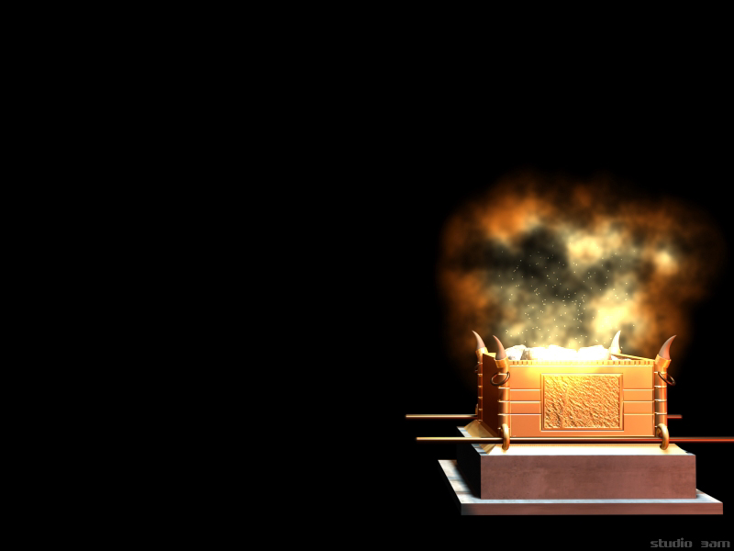
PURPOSE OF OFFERINGS IN WORSHIP
PROTECTION (Piritsi)
Cure of Selfishness (Chindiniosis)
DEVELOPMENT
Character development
Sense of Responsibility
System of judging Motive
PRIVILEGE/RELATIONSHIP
Joy of Sharing
Partnership

Slide 13
Combine Offerings
All offerings go to the same general fund and are then allocated to the different departments, Institutions and mission projects according to a distribution ratio voted by the General Conference & Divisions as shown below:

Slide 15
STEWARDSHIP MINISTRIES
North Zimbabwe Conference
Tithe

Slide 16
STEWARDSHIP MINISTRIES
North Zimbabwe Conference
RELATIONSHIP BETWEEN TITHE & OFFERINGS
Tithe
10%
Recognition
Offerings
%++
Gratitude
My Lord/Creator
My Saviour
Trustworthiness
(Akavimbika)

Slide 17
The Tithe Principle is Divine In Origin
Gen 14:18-21
“And Mel-chiz'edek king of Salem brought out bread and wine; he was priest of God Most High. 19 And he blessed him and said,
"Blessed be Abram by God Most High,
maker of heaven and earth;
20 and blessed be God Most High,
who has delivered your enemies into your hand!"
And Abram gave him a tenth of everything.”
RSV
Heb. 7:6-7
But this man who has not their genealogy received tithes from Abraham and blessed him who had the promises.
RSV

Slide 18
What is Tithe?
It is a tenth portion of our income/increase
Lev. 27: 30 – A tithe of everything from the land, whether grain from the soil or fruit from the trees, belongs to the Lord, it is holy to the Lord.
It is a test of loyalty
A sign of God’s Creatorship
It is determined and stipulated by God
You cannot use it as you wish

Slide 19
How Is The Tithe Collected & What Is The Tithe Used For?
Tithe is to be collected by the local churches, and all of it is to be forwarded to the local conference. Local churches are under no circumstances to retain any portion of the tithe. Local conferences in turn take a portion of the tithe for the uses listed below, and forward the remainder to the union. The union does the same, forwarding the remainder to the division, and the division forwards the remainder to the GC.

Slide 20
Acceptable Uses Of Tithe
1.Support of Pastors, Evangelists, Ministers
World Missions.
2. Soul-winning Support Personnel
3. Conference/Mission Operating Expense
4. Literature Evangelist Benefit Fund
5. Subsidies for Specified Activities (such as youth evangelism camps)
6. Evangelistic and Conference/Mission Office Equipment
7. Bible/Religion Teaching and Support
8. Personnel in Schools
9. Retired Employees

Slide 21
Unacceptable Uses Of The Tithe
Capital Expenditures for Buildings and Churches
2. Equipment (other than for conference/mission use)
3. Local Church Operating Expense
4. Schools Operating Expense

Slide 22
Ndouya KuMchinjiko – Hymn 21
Ndouya kumchinjiko, ubofo neurombo
Handidi chimwe chiro asi ruponeso-ro.
Ndosimbira kunemwi, Nyenye yepaCalvary
Ndinopfugama pasi, mundiponese ini.
Jesu ndokuchemera, Moyo wangu waipa
Jesu ye wataura, Ndinozo-kuchenura.
Ndapa zvese kunemi, zviro zvese zvepasi
Moyo zve nemuviri, uwe wenyu narini.
Ndosimbira kunemi, mune zvitsidzo zvenyu
Zvino ndarapwa ini, neroparo raKristu.
Jesu arikuuya; Moyo wangu wazara
Zvino ndakachenurwa; Mbiri kuna Jehova.

