Slide 1
BUILDING A CULTURE OF FAITHFULNESS

Slide 2
God’s prescription
God encourages us as His children to be:
Generous
Liberal
Big-hearted
Open-handed
Munificent (unsparing)
Kind
Charitable

Slide 3
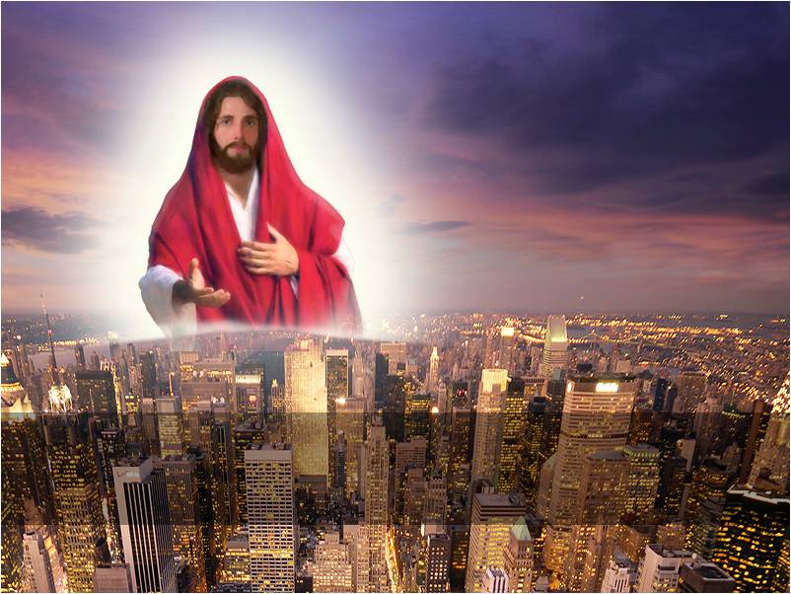
GOD IS A GREAT GIVER
JESUS GAVE HIS LIFE AS A RANSOM FOR THE WORLD

Slide 4
GOD AND GIVING
GOD IS A GIVER
HE LOVES GIVING AS A DEMONSTRATION OF HIS LOVE
JOHN 3: 16 – For God so loved the world that He gave His only begotten Son …
YOU CAN NOT LOVE AND FAIL TO GIVE, BUT YOU CAN GIVE WITHOUT LOVING

Slide 5
God is a generous giver
He waters the fields of the saint and the fields of the witch/wizard
His sun shines upon the pastor and upon the robber
24 hours are equally given to the prayer band leader and the prostitute.
What can we say then: GOD IS LOVE INDEED
Stewards are to be seriously generous

Slide 6
REASONS FOR NOT GIVING
I do not have enough
What will they give me in return
I have worked and sweated alone
They are not grateful
They are not my relations
Am I the one to deal with their problems
Its not even enough for my family
Things are hard

Slide 7
GOD’S FORMULAR FOR BLESSINGS
ACTS 20: 35 … it is more blessed to give than to receive.
Many people are powerful receivers.
Many testimonies are based on receiving
You give and you are more blessed
You receive and you are less blessed

Slide 8
GOD’S FORMULAR WORKS
1 KINGS 17: 9 – 16
The widow of Zarephath
Vs 13 Elijah said to her, “Do not be afraid, go home and do as you have said, but first make small cake of bread for me from what you have and bring it to me, and then make something for yourself and your son.
Vs 14 The Lord had promised that the little flour and the little oil was not going to be used up.

Slide 9
Luke 6: 38 – Give and it shall be given unto you; a good measure, pressed down, shaken together, and running over will be put into your bosom. For with the same measure that you use, it will be measured back to you.
Prov. 19: 17 – He who has pity on the poor lends to the Lord, and He will pay back what he has given
Prov . 28: 27 – He who gives to the poor will not lack, but he who hides his eyes will have many curses

Slide 10
WHY SHOULD WE BECOME GIVERS?
GIVING CARRIES WITH IT GREAT BLESSINGS
GIVING DEVELOPS IN YOU A CHRISTLIKE CHARACTER
GIVING HELPS YOU TO VALUE OTHERS MORE THAN YOURSELF
IT BENEFITS YOU THE GIVER MORE THAN THE ONE RECEIVING

Slide 11
Prov. 11: 24 – There is one who scatters, yet increase more, and there is one who withholds more than is right, but leads to poverty
Prov. 22: 9 - He who has a generous eye will be blessed, for he gives of his bread to the poor

Slide 12
MAY GOD BLESS YOU AS YOU START RIGHT AWAY TO BE A GENEROUS GIVER.
AMEN!!

